Slide 1

HallyuGo:
A Guide Map to Discover and Visit K-Contents and K-Culture Hotspots
Team 4.75 김지수 이유진 정대교 Jose Antunes
Notes:
Hello everyone, today I will be talking our rough topic, platform for skku foreign students

Slide 2
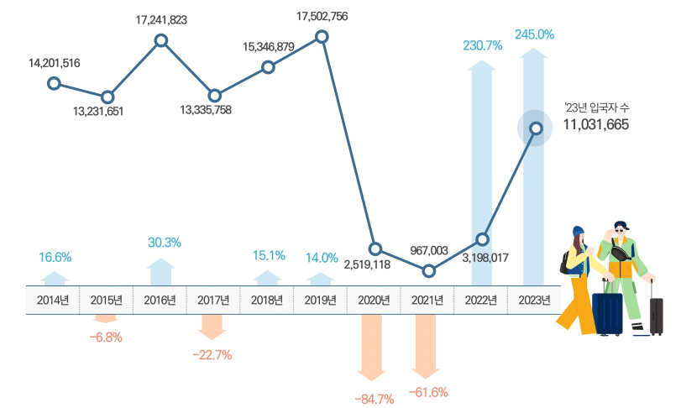
Background
✈️Changes in the number of arrivals by year
Notes:
[graph] According to the Korea Tourism Organization, the number of South Korean arrivals, which had plummeted due to the COVID-19, rose again, reaching about 11 million last year.

Slide 3
Background
🤔Why do you want to visit Korea?
32.1%
31.1%
26.4%
25.4%
Korean
Wave
Contents
Korean
Traditional
Culture
New
Country
Visit
Past
Visit
Experience
Notes:
[graph] ranking of trigger for interest in visiting Korea (duplicate response)
1st - 32.1% - to enjoy korean wave contents
2nd - 31.1% - to enjoy korean traditional culture
3rd - 26.4% - to go a new country (first visit)
4th - 25.4% - due to past visit experience (revisit)
-> so we propose service for visitors who love K-contents and K-culture, and make the interests of them continue in long term, not temporary. (So that they can revisit Korea in future with a good experience) -> This is followed by the content of the next slide.

Slide 4
Objective
🎯Target
Anyone who loves K-Contents and K-Culture, including visitors
🎯What
Information of hotspots related to K-Contents and K-Culture
🎯How
Guide map application for K-Contents and K-Culture hotspots
Notes:
our objective starting from background
if this is not appropriate, you can modify

Slide 5
Related works
🗺️Google maps
Route navigation
Location sharing
Place search
Street view
Review and rating
Only location information
🧳Viator
Travel platform
Activity booking
Themed tour options
Payment options
Review and rating
Focused on commerce
Notes:
two related works and their core features. (I think you don’t need to read all features maybe.)
the red text is their limitation and it leads to the “problem statement” of next slide.
[limitation]
google maps provides not “cultural context(background information, url, image about K-contents)” but only “location information”
viator is focused on commerce rather than tour information

Slide 6
Problem statement and justification
Lack of cultural context and depth
➡️Lack of rich cultural experience
➡️Temporary interest in K-Contents and K-Culture
If this is solved, this will contribute to…
- Korean tourism industry
- Global Hallyu fandom
Notes:
If the cultural context and depth of the place related to Hallyu content are not sufficiently delivered, interest in Korean culture may not be maintained in the long term due to a lack of rich cultural experience.
Therefore, when a user visits a specific place, it is necessary to provide a cultural experience beyond simple tourism by delivering background information on K-contents and K-culture related to the place. Through this, it will contribute to the revival of korean tourism industry and the formation of a global K-cultural fandom.

Slide 7
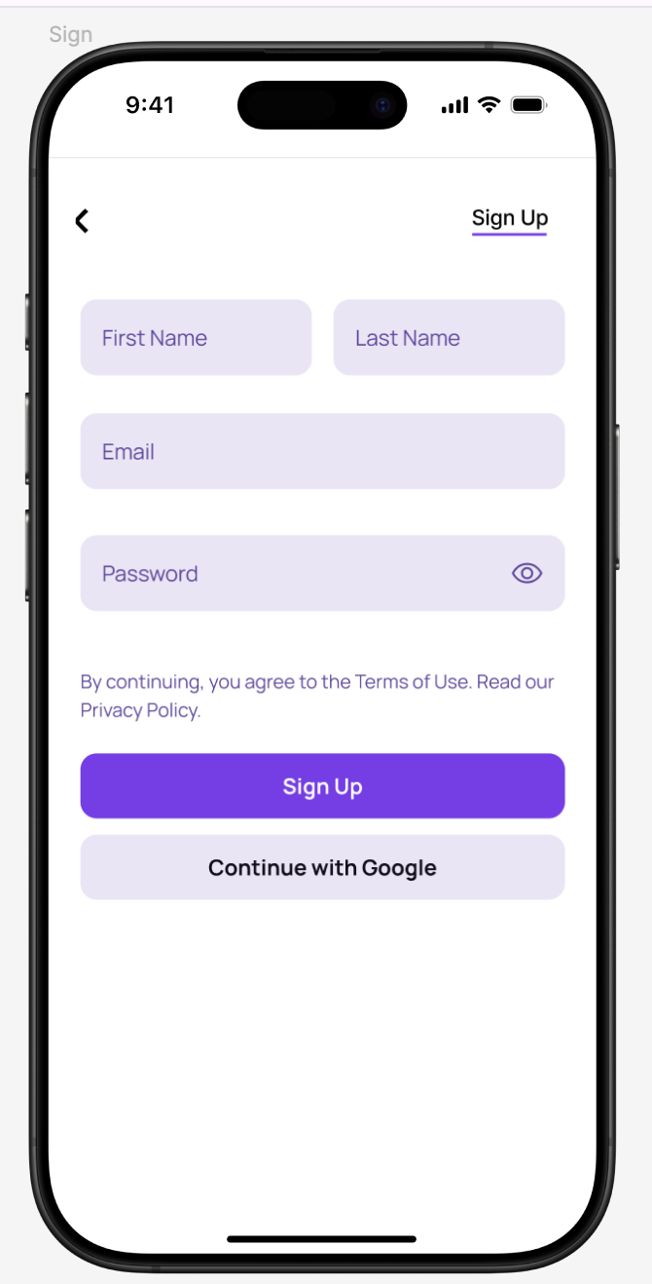
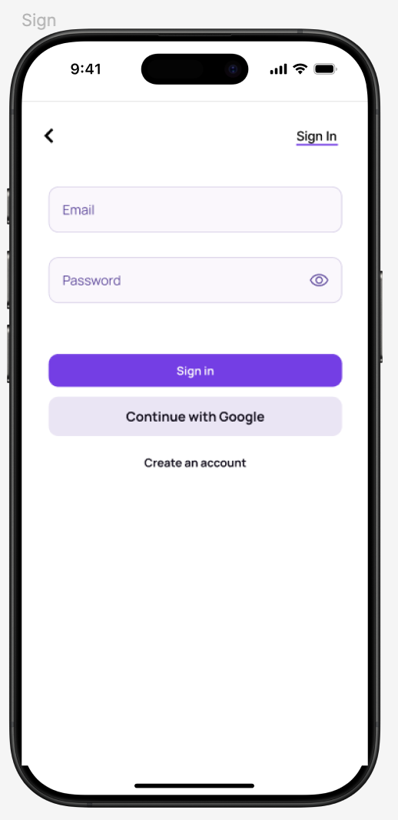
Features: Sign in/up
With an E-mail or Google account

Slide 8
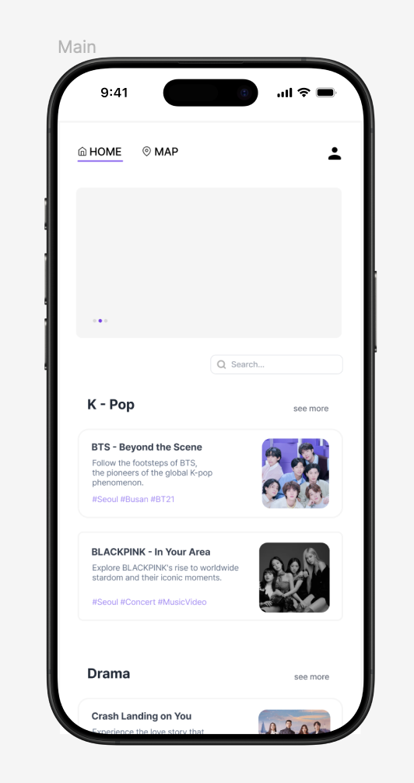
Features: Main page
Navigator
Home, Map, My Page
Carousel
Recommended locations, Advertisements
Category sections with cards
Top 2 rated contents in each category
Hashtag
Searchbar
Find Contents and locations

Slide 9
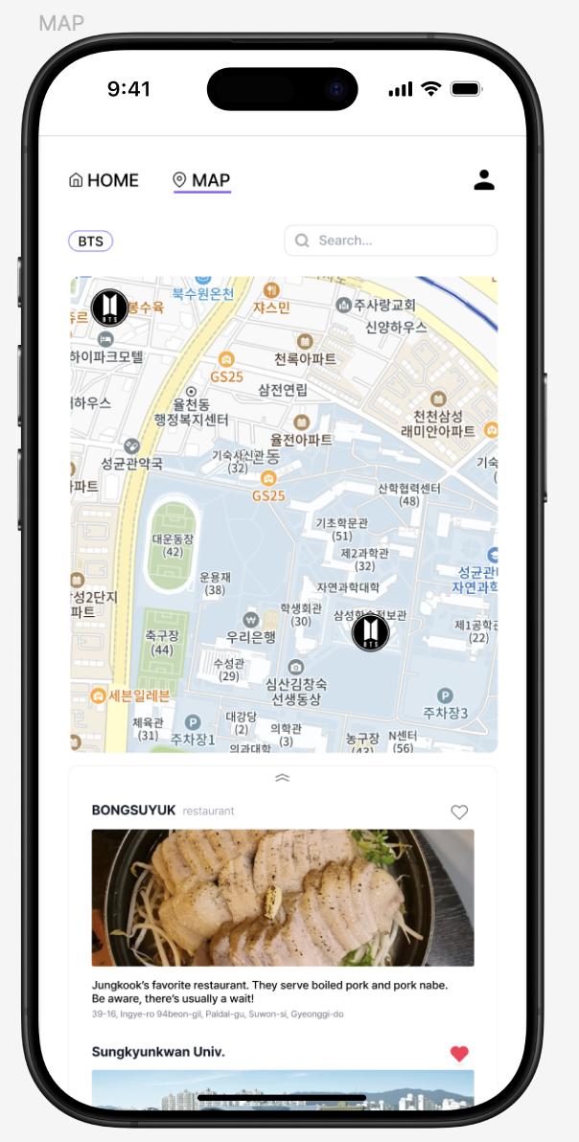
Features: Map page
Navigator
Home, Map, My Page
Map
locations with a badge
Detail Card List
Contain Title, favorite button, photo and brief information.
Searchbar
Find Contents and locations

Slide 10
Features: Detail page, My page
Detail Page
If click the card or badge on the map, redirect to detail page
Detail information
Operating hours
Source content reference
Comments
Review from other users
Proof shot
Recommended Pose
Share with others
My Page
Mini Map
View overall location badges with favorites
Card List
Manage favorites
My Proof Shots
Collect Stamps
View all my proof shots

Slide 11
Tech Stack
Frontend | Backend
React.js TailwindCSS PWA | Spring Boot MySQL Spring Security
Git Figma

Slide 12

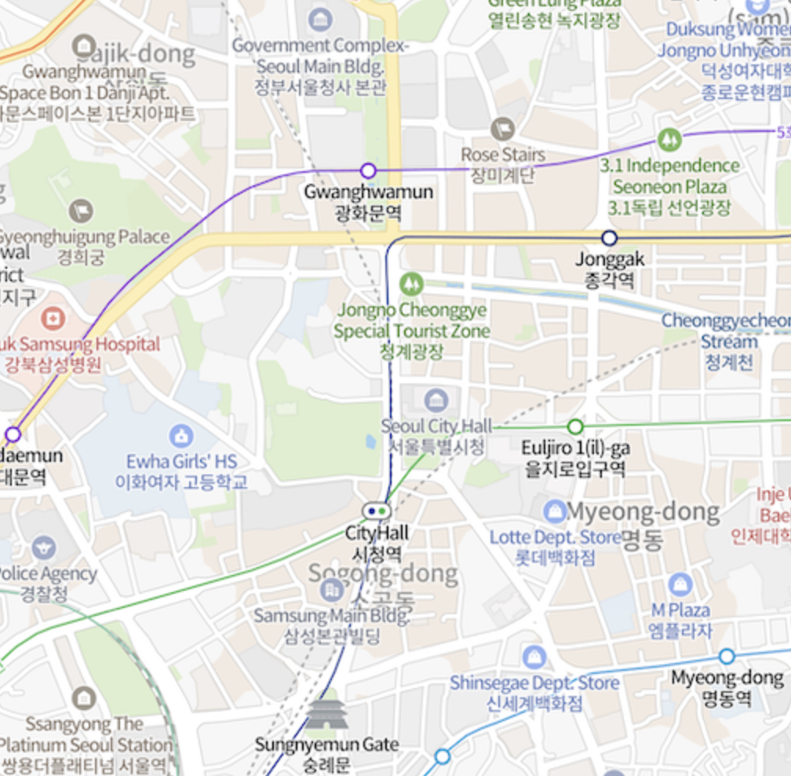
Naver Map API
Precise map data in Korea
Supports English address on the map

Slide 13



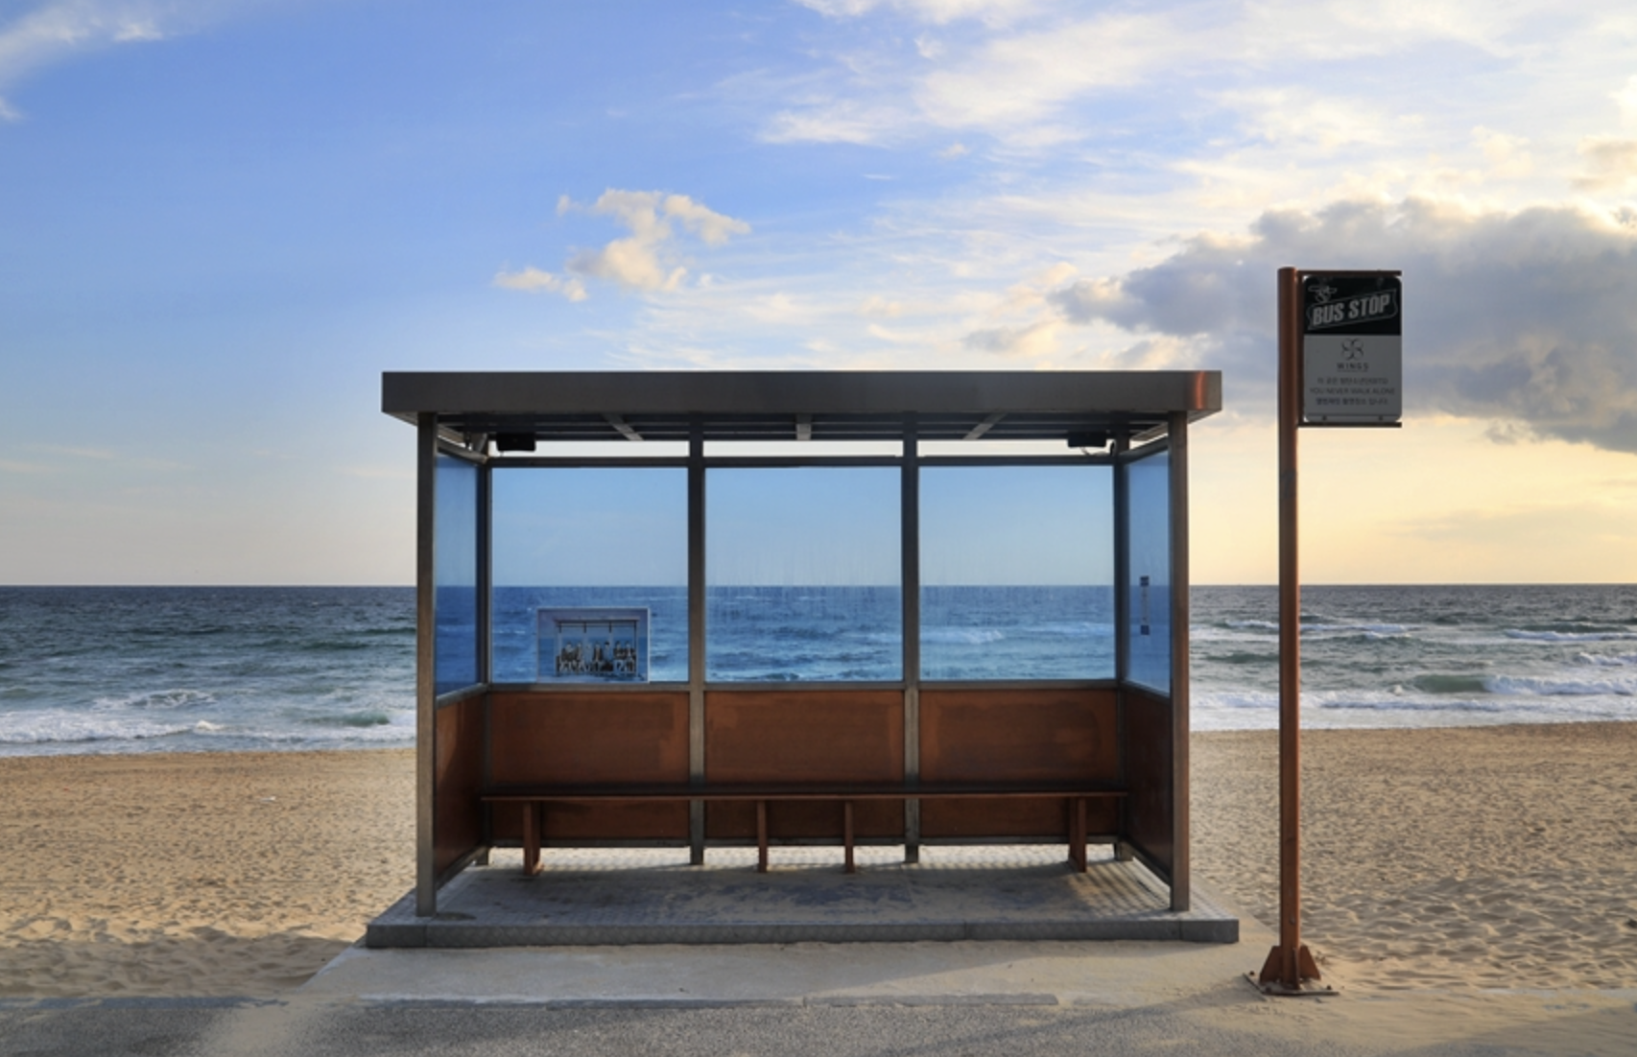
Information displayed on the map
K-Drama, K-Movie filming locations
K-POP music video filming locations
K-Novel
Queen of tears Hangang view
BTS - Spring Day
Jumunjin Beach

Slide 14
Roles
Data collection
Frontend | Backend
José Antunes Yoo-Jin Lee | Dae-Gyo Jung Ji-Su Kim
Notes:
data collection - everyone.

Slide 15
Schedule
Weeks | 2 - 3 | 4 - 5 | 6 - 7 | 8 - 9 | 10 - 11 | 12 - 13 | 14 - 15
Refinement of Topic
UI & UX Design
DB Design
Implementation
Data Collection
Testing & Deployment

Slide 16
Thank you for listening

